Slide 1
Analytical Methods for Business
Dr. Ronald K. Satterfield
Muma College of Business
University of South Florida

Slide 2
Module 2 Probability Distributions & CLT
Dr. Ronald K. Satterfield
Muma College of Business
University of South Florida
The “Shape” of Data

Slide 3
Plan for This Presentation
Building on the Video Lecture
Concentrating on R
Extracting Probabilities
Generating Random Numbers
Assessing Normality
Other Statistical Distributions
Module Assignment
Lecture Plan | Normal Distrs. in R | Assessing Normality | Other Distributions
Uniform Distributions | The FOR Statement | The Weibull Distribution | Assignment

Slide 4
Normal Distributions in R
rnorm – generates random numbers
dnorm – gives individual probability for a Z value
pnorm – gives the cumulative probability of a value on a distribution
qnorm – gives a value associated with a given probability
Lecture Plan | Normal Distrs. in R | Assessing Normality | Other Distributions
Uniform Distributions | The FOR Statement | The Weibull Distribution | Assignment

Slide 5
Putting the Normal Distribution to Work Areas Under the Normal Curve
Mean = 72
Standard Deviation = 14
This Year's Sales = 1,000,000 units
Warranty Replacement Cost = $200
Lecture Plan | Normal Distrs. in R | Assessing Normality | Other Distributions
Uniform Distributions | The FOR Statement | The Weibull Distribution | Assignment

Slide 6
Assessing Normality
Histogram/Density Plot
Q-Q Plot with Line
Lecture Plan | Normal Distrs. in R | Assessing Normality | Other Distributions
Uniform Distributions | The FOR Statement | The Weibull Distribution | Assignment

Slide 7
Distributions in R
Normal
t
F
Uniform
Poisson
Exponential
Weibull
Binomial
Wilcoxon
Beta
Gamma
Geometric
Logistic
AND OTHERS
Lecture Plan | Normal Distrs. in R | Assessing Normality | Other Distributions
Uniform Distributions | The FOR Statement | The Weibull Distribution | Assignment

Slide 8
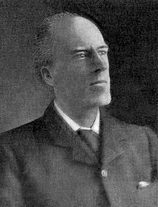
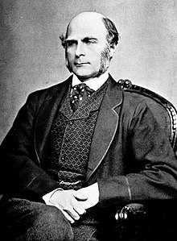
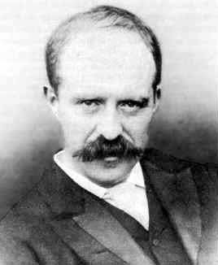
Biometrika – Publishing Statistical Research
Karl Pearson
Francis Galton
Raphael Weldon
Lecture Plan | Normal Distrs. in R | Assessing Normality | Other Distributions
Uniform Distributions | The FOR Statement | The Weibull Distribution | Assignment

Slide 9
The Uniform Distribution
Lecture Plan | Normal Distrs. in R | Assessing Normality | Other Distributions
Uniform Distributions | The FOR Statement | The Weibull Distribution | Assignment

Slide 10
Comparing Curves – Normal Distributions
Lecture Plan | Normal Distrs. in R | Assessing Normality | Other Distributions
Uniform Distributions | The FOR Statement | The Weibull Distribution | Assignment

Slide 11
The Weilbull Distribution
Lecture Plan | Normal Distrs. in R | Assessing Normality | Other Distributions
Uniform Distributions | The FOR Statement | The Weibull Distribution | Assignment

Slide 12
Basic Data Frames

Slide 13
Assignment
Lecture Plan | Normal Distrs. in R | Assessing Normality | Other Distributions
Uniform Distributions | The FOR Statement | The Weibull Distribution | Assignment

